Slide 1
Information Security 1

Slide 2
TOPIC DISCUSSION
10
Network Design
10.1
10.9
10.2
The OSI Model
Telephony
10.3
Switches
10.4
Routers
10.5
Network Zones
10.6
Network Access Control
10.7
VLANS
10.8
Subnetting
Network Address Translation

Slide 3
TOPIC DISCUSSION
11
Perimeter Security
11.1
11.2
Firewalls
11.3
Proxy Servers
11.4
Honeypots and Honeynets
11.5
Data Loss Prevention
11.6
NIDS and NIPS
Unified Threat Management

Slide 4
TOPIC DISCUSSION
12
Cloud Security
12.1
12.2
Cloud Types
12.3
As a Service
12.4
Cloud Security
Defending Servers

Slide 5
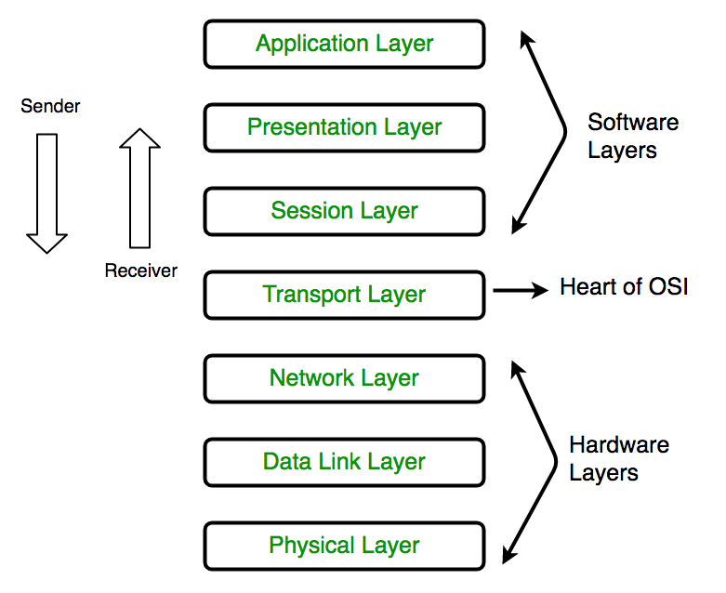
The OSI Model
Notes:
1. Physical Layer (Layer 1) :
The lowest layer of the OSI reference model is the physical layer. It is responsible for the actual physical connection between the devices. The physical layer contains information in the form of bits. It is responsible for transmitting individual bits from one node to the next. When receiving data, this layer will get the signal received and convert it into 0s and 1s and send them to the Data Link layer, which will put the frame back together.
2. Data Link Layer (DLL) (Layer 2) :
The data link layer is responsible for the node to node delivery of the message. The main function of this layer is to make sure data transfer is error-free from one node to another, over the physical layer. When a packet arrives in a network, it is the responsibility of DLL to transmit it to the Host using its MAC address.
3. Network Layer (Layer 3) :
Network layer works for the transmission of data from one host to the other located in different networks. It also takes care of packet routing i.e. selection of the shortest path to transmit the packet, from the number of routes available. The sender & receiver’s IP address are placed in the header by the network layer.
4. Transport Layer (Layer 4) :
Transport layer provides services to application layer and takes services from network layer. The data in the transport layer is referred to as Segments. It is responsible for the End to End Delivery of the complete message. The transport layer also provides the acknowledgement of the successful data transmission and re-transmits the data if an error is found.
5. Session Layer (Layer 5) :
This layer is responsible for establishment of connection, maintenance of sessions, authentication and also ensures security.
6. Presentation Layer (Layer 6) :
Presentation layer is also called the Translation layer. The data from the application layer is extracted here and manipulated as per the required format to transmit over the network.
7. Application Layer (Layer 7) :
At the very top of the OSI Reference Model stack of layers, we find Application layer which is implemented by the network applications. These applications produce the data, which has to be transferred over the network. This layer also serves as a window for the application services to access the network and for displaying the received information to the user.

Slide 6
The OSI Model
The Open System Interconnection (OSI) model defines a networking framework to implement protocols in seven layers. Use this handy guide to compare the different layers of the OSI model and understand how they interact with each other.

Slide 7
Switches
A switch in an Ethernet-based LAN reads incoming TCP/IP data packets/frames containing destination information as they pass into one or more input ports. The destination information in the packets is used to determine which output ports will be used to send the data on to its intended destination.
Notes:
Switches are similar to hubs, only smarter. A hub simply connects all the nodes on the network -- communication is essentially in a haphazard manner with any device trying to communicate at any time, resulting in many collisions. A switch, on the other hand, creates an electronic tunnel between source and destination ports for a split second that no other traffic can enter. This results in communication without collisions.
Switches are similar to routers as well, but a router has the additional ability to forward packets between different networks, whereas a switch is limited to node-to-node communication on the same network.

Slide 8
Routers
A device that connects two or more networks and allows packets to be transmitted and received between them. A router determines the best path for data packets from source to destination.

Slide 9
Network Zones
A security zone is an area in a building where access is individually monitored and controlled. A large network, such as a large physical plant, can have many areas that require restricted access. In a building, floors, sections of floors, and even offices can be broken down into smaller areas.
Notes:
These smaller zones are referred to as security zones. In the physical environment, each floor is broken into separate zones. An alarm system that identifies a zone of intrusion can inform security personnel about an intruder’s location in the building; zone notification tells them where to begin looking when they enter the premises.

Slide 10
Network Access Control
One of the basic security objectives set forth by most organizations is controlling access to the organization’s network. Network access control (NAC) solutions help security professionals achieve two cybersecurity objectives: limiting network access to authorized individuals and ensuring that systems accessing the organization’s network meet basic security requirements.
Notes:
The 802.1x protocol is a common standard used for NAC. When a new device wishes to gain access to a network, either by connecting to a wireless access point or plugging into a wired network port, the network challenges that device to authenticate using the 802.1x protocol. A special piece of software, known as a supplicant, resides on the device requesting to join the network. The supplicant communicates with a service known as the authenticator that runs on either the wireless access point or the network switch. The authenticator does not have the information necessary to validate the user itself, so it passes access requests along to an authentication server using the RADIUS protocol. If the user correctly authenticates and is authorized to access the network, the switch or access point then joins the user to the network. If the user does not successfully complete this process, the device is denied access to the network or may be assigned to a special quarantine network for remediation.

Slide 11
VLANS
A virtual local area network (VLAN) allows you to create groups of users and systems and segment them on the network. This segmentation lets you hide segments of the network from other segments and thereby control access. You can also set up VLANs to control the paths that data takes to get from one point to another. A VLAN is a good way to contain network traffic to a certain area in a network.
Notes:
On a LAN, hosts can communicate with each other through broadcasts, and no forwarding devices, such as routers, are needed. As the LAN grows, so too does the number of broadcasts. Shrinking the size of the LAN by segmenting it into smaller groups (VLANs) reduces the size of the broadcast domains. The advantages of doing this include reducing the scope of the broadcasts, improving performance and manageability, and decreasing dependence on the physical topology. From the standpoint of this exam, however, the key benefit is that VLANs can increase security by allowing users with similar data sensitivity levels to be segmented together.

Slide 12
Subnetting
Subnetting divides a single range of IP addresses into several smaller ranges of IP addresses. This is often done to isolate traffic and increase efficiency. You don’t need to know how to subnet for the CompTIA Security+ exam, but you should be familiar with the concept and how it can be used to isolate users onto different subnets. Additionally, you should be able to identify valid IP addresses for computers within a subnet.
Notes:
As an example, you could have multiple users on a single Class C network. Some of the users may be running applications that stream audio and video across the network. A second group of users may regularly upload and download data via the Internet. A third group may upload and download files back and forth to servers on the network, and a fourth group could be users with just occasional access to the network. By subnetting a single Class C network into four smaller subnets, it isolates the traffic for each of these user groups.

Slide 13
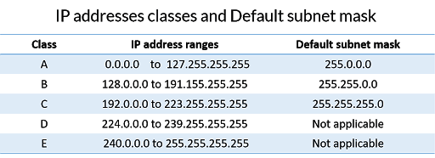
Subnetting
Notes:
The subnetting process allows the administrator to divide a single Class A, Class B, or Class C network number into smaller portions. The subnets can be subnetted again into sub-subnets.

Slide 14
Network Address Translation
Network Address Translation (NAT) creates a unique opportunity to assist in the security of a network. Originally, NAT extended the number of usable Internet addresses. Now it allows an organization to present a single address to the Internet for all computer connections. The NAT server provides IP addresses to the hosts or systems in the network and tracks inbound and outbound traffic
Notes:
A company that uses NAT presents a single connection to the network. This connection may be through a router or a NAT server. The only information that an intruder will be able to get is that the connection has a single address. NAT effectively hides your network from the world, making it much harder to determine what systems exist on the other side of the router. The NAT server effectively operates as a firewall for the network. Most new routers support NAT translation; it provides a simple inexpensive firewall for small networks.

Slide 15
Telephony
IP or Internet telephony is the latest terminology related to data/voice communication. It uses the Internet as a medium of communication. IP telephony allows data communication in which voice, fax or digital information can be transmitted over the Internet.

Slide 16
Firewalls
Firewalls are one of the first lines of defense in a network. There are different types of firewalls, and they can be either stand-alone systems or included in other devices such as routers or servers. You can find firewall solutions that are marketed as hardware-only and others that are software-only. Many firewalls, however, consist of add-in software that is available for servers or workstations.
Notes:
The basic purpose of a firewall is to isolate one network from another. Firewalls are becoming available as appliances, meaning they’re installed into the network between two networks. Appliances are freestanding devices that operate in a largely self-contained manner, requiring less maintenance and support than a server-based product. Firewalls function as one or more of the following: Packet filter Proxy firewall Stateful inspection
To understand the conce

Slide 17
Firewalls
Packet Filter Firewalls
A firewall operating as a packet filter passes or blocks traffic to specific addresses based on the type of application. The packet filter doesn’t analyze the contents of a packet; it decides whether to pass it based on the packet’s addressing information.
Notes:
For instance, a packet filter may allow web traffic on port 80 and block Telnet traffic on port 23. This type of filtering is included in many routers. If a received packet request asks for a port that isn’t authorized, the filter may reject the request or simply ignore it. Many packet filters can also specify which IP addresses can request which ports and allow or deny them based on the security settings of the firewall. Packet filters are growing in sophistication and capability. A packet filter firewall can allow any traffic that you specify is acceptable. For example, if you want web users to access your site, then you configure the packet filter firewall to allow data on port 80 to enter. If every network was exactly the same, then firewalls would come with default port settings hard coded; but networks vary, so the firewalls don’t include such settings.

Slide 18
Firewalls
Stateful Inspection Firewalls
Stateful inspection is also referred to as stateful packet filtering. Most of the devices used in networks don’t keep track of how information is routed or used. Once a packet is passed, the packet and path are forgotten. In stateful inspection (or stateful packet filtering), records are kept using a state table that tracks every communications channel.
Notes:
Stateful inspections occur at all levels of the network and provide additional security, especially in connectionless protocols such as User Datagram Protocol (UDP) and Internet Control Message Protocol (ICMP). This process adds complexity to the process. Denial of service (DoS) attacks present a challenge because flooding techniques are used to overload the state table and effectively cause the firewall to shut down or reboot.

Slide 19
Proxy Servers
A proxy firewall can be thought of as an intermediary between your network and any other network. Proxy firewalls are used to process requests from an outside network; the proxy firewall examines the data and makes rules-based decisions about whether the request should be forwarded or refused. The proxy intercepts all the packages and reprocesses them for use internally. This process includes hiding IP addresses.
Notes:
The proxy firewall provides better security than packet filtering because of the increased intelligence that a proxy firewall offers. Requests from internal network users are routed through the proxy. The proxy, in turn, repackages the request and sends it along, thereby isolating the user from the external network. The proxy can also offer caching, should the same request be made again, and increase the efficiency of data delivery. A proxy firewall typically uses two NIC cards. This type of firewall is referred to as a dualhomed firewall. One of the cards is connected to the outside network, and the other is connected to the internal network. The proxy software manages the connection between the two NIC cards. This setup segregates the two networks from each other and offers increased security. Figure 3.3 illustrates a dual-homed firewall segregating two networks from each other.

Slide 20
Honeypots and Honeynets
A honeypot is a decoy computer system for trapping hackers or tracking unconventional or new hacking methods. Honeypots are designed to purposely engage and deceive hackers and identify malicious activities performed over the Internet. While Honeynets purposely include system vulnerabilities and aid in better understanding hacker and cracker behavior (and the motivations behind their behaviors).

Slide 21
Data Loss Prevention
DLP is a method of inspecting and keeping sensitive data from leaving the allowed perimeter. DLP systems are only concerned with the data passing over some kind of perimeter gateway device, such as through emails, instant messages and Web 2.0 applications.
Notes:
DLP has the following key features:
It is configurable with automated remediation. From a financial perspective, this can significantly reduce the expense associated with remediation. Automatic remediation may differ depending on the kind of activity involved. For instance, the user may opt to encrypt, quarantine, block and/or notify the sender in the event of an email. The majority of the functions mentioned earlier could be completed using a protected email product.
It is able transfer data to a safe location if the data is found to be located in an unprotected area.
It removes the need for manual user lookups through the use of LDAP server/active directory. This feature is common among all DLP manufacturers.

Slide 22
NIDS and NIPS
A network-based intrusion detection system (NIDS) monitors activity on the network. An administrator installs NIDSs sensors on network devices such as routers and firewalls. These sensors gather information and report to a central monitoring server hosting a NIDS console. Network-based intrusion prevention system (NIPS). An IPS that monitors the network. An IPS can actively monitor data streams, detect malicious content, and stop attacks in progress.
Notes:
A NIDS is not able to detect anomalies on individual systems or workstations unless the anomaly causes a significant difference in network traffic. Additionally, a NIDS is unable to decrypt encrypted traffic. In other words, it can only monitor and assess threats on the network from traffic sent in plain text or non-encrypted traffic.
—

Slide 23
Unified Threat Management
The emergence of unified threat management is a relatively new phenomenon, because the various aspects that make up these products used to be sold separately. However, by selecting a UTM solution, businesses and organization can deal with just one vendor, which may be more efficient. Unified threat management solutions may also promote easier installation and updates for security systems, although others contend that a single point of access and security can be a liability in some cases.

Slide 24
Cloud Types
Cloud computing is provided by cloud providers and is very useful for heavily utilized systems and networks. Software as a Service (SaaS) is used for web-based applications. Infrastructure as a Service (IaaS) is also known as Hardware as a Service. Platform as a Service (PaaS) provides easy-to-configure operating systems.

Slide 25
As a Service
Software as a Service
Software as a Service (SaaS) includes any software or application provided to users over a network such as the Internet. Internet users access the SaaS applications with a web browser. It usually doesn’t matter which web browser or operating system a SaaS customer uses. They could be using Internet Explorer, Chrome, Firefox, or just about any web browser.
Notes:
Applications such as web-based e-mail provided over the Internet are Software as a Service (SaaS) cloudbased technologies. Internet users access SaaS applications with a web browser. Data hosted in the cloud presents a security concern.

Slide 26
As a Service
Infrastructure as a Service
Infrastructure as a Service (IaaS) allows an organization to outsource its equipment requirements, including the hardware and all of its support operations. The IaaS service provider owns the equipment, houses it in its datacenter, and performs all of the required maintenance. The customer essentially rents access to the equipment and often pays on a per-use basis.
Notes:
Infrastructure as a Service (IaaS) is also known as Hardware as a Service. Organizations can limit their hardware footprint and personnel costs by renting access to hardware such as servers. The IaaS provider maintains the server.

Slide 27
As a Service
Platform as a Service
Platform as a Service (Paas) provides customers with a computing platform they can use to configure and manipulate as needed. It provides the customer with an easy-to-configure operating system, combined with ondemand computing.
Notes:
Platform as a Service (PaaS) provides cloud-computing customers with an easy-to-configure operating system, combined with on-demand computing.

Slide 28
Cloud Security
One of the primary drawbacks to cloud computing is that you lose physical control of your data. You often won’t even know where the data is stored. Employees at the cloud datacenter can easily steal your data, and you may not know it until the thief has exploited the data. It’s also possible for employees to make mistakes that suddenly grant access to your data to anyone.
Notes:
Many cloud-computing solutions are blended. They combine data and operating systems, located in the cloud. While this can provide benefits since you reduce your own datacenter’s footprint, it also presents risks.
Many security professionals say that the only data you should put in the cloud is data you’re willing to give away. After all, that’s exactly what you may be doing.

Slide 29
Cloud Security
Cloud security is the protection of data, applications, and infrastructures involved in cloud computing. Many aspects of security for cloud environments (whether it’s a public, private, or hybrid cloud) are the same as for any on-premise IT architecture.

Slide 30
Defending Servers

